Slide 1
Azure Data Factory
Dutch Azure Meetup
Marco Mansi

Slide 2
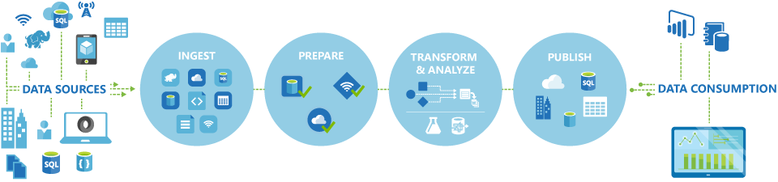
Data Factory is a cloud-based data integration service that orchestrates and automates the movement and transformation of data

Slide 3
Azure Data Factory
Enable Enterprises To ingest data from multiple on-premises and cloud sources easily, and gets your data where it needs to go. Prepare and partition your data as you ingest it, or apply pre-processing steps.
Allows you to create data pipelines That move and transform data, and then run the pipelines on a specified schedule (hourly, daily, weekly, etc..)
Provides rich visualizations To display the lineage and dependencies between your data pipelines, and monitor all your data pipelines from a single unified view

Slide 4


Slide 5

What can we use Data Factory for?
Use it to ingest data from multiple on-premises and cloud sources.
Schedule, orchestrate, and manage the data transformation and analysis process.
Transform raw data into finished or shaped data that's ready for consumption by BI tools or by your onpremises or cloud applications and services.
Manage your entire network of data pipelines at a glance to identify issues and take action

Slide 6

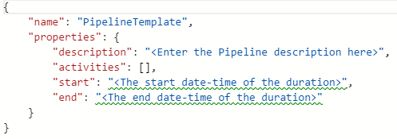
What is a Pipeline
A pipeline is a logical grouping of activities. They are used to group activities into a unit that together perform a task.
To understand pipelines better, you need to understand an activity first

Slide 7
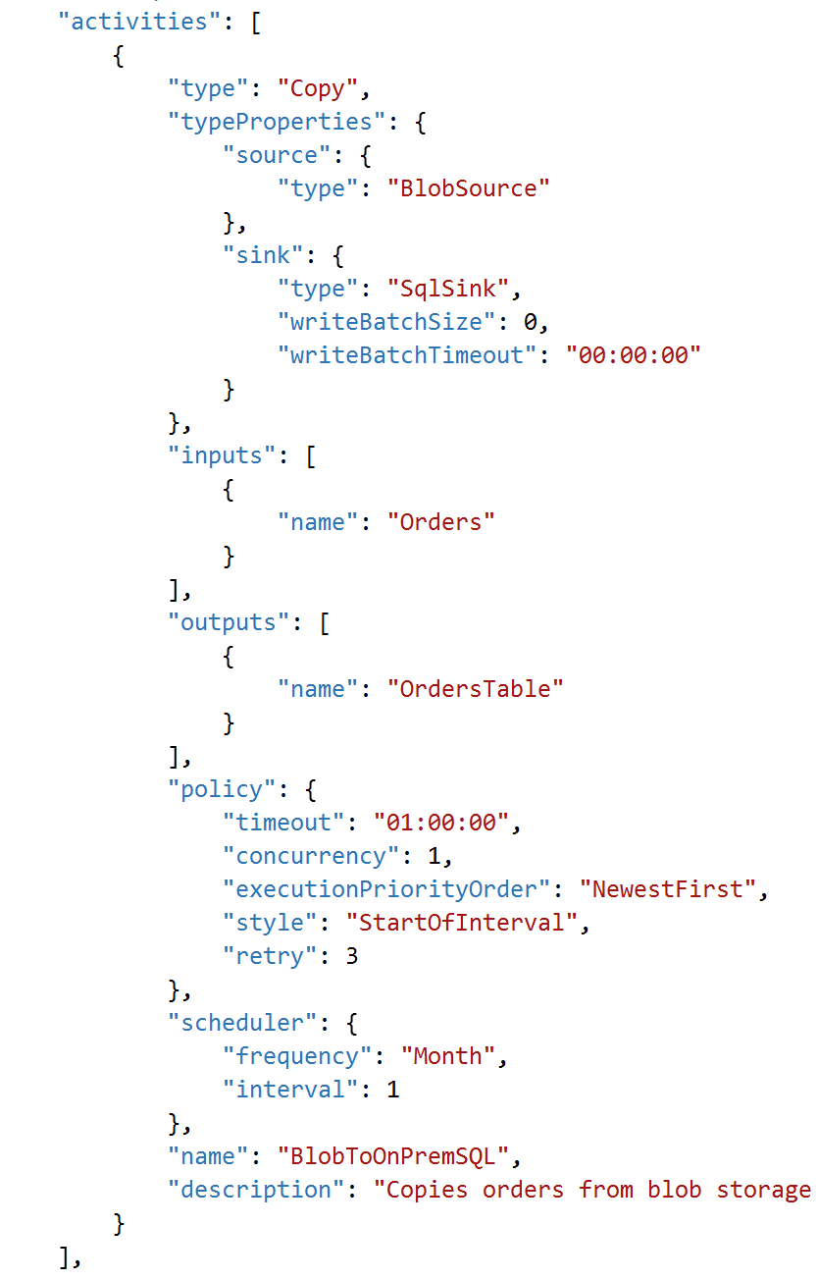
What is an Activity
Activities define the actions to perform on your data.
For example, you may use a Copy activity to copy data from one data store to another data store. Similarly, you may use a Hive activity, which runs a Hive query on an Azure HDInsight cluster to transform or analyze your data. You may also choose to create a custom .NET activity to run your own code

Slide 8
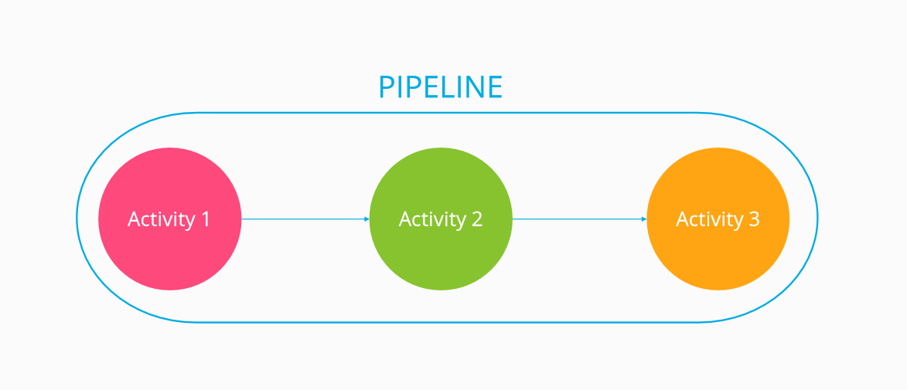

Slide 9
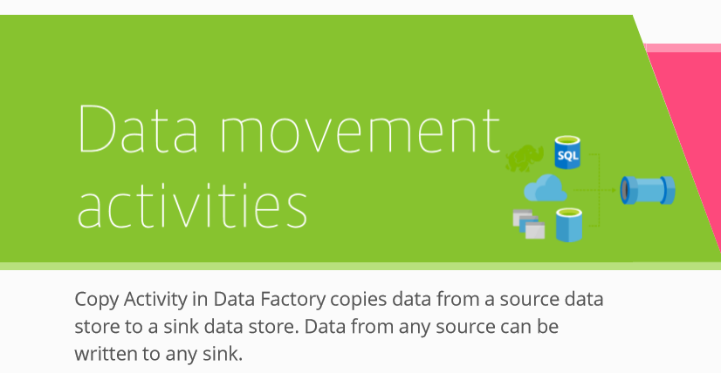
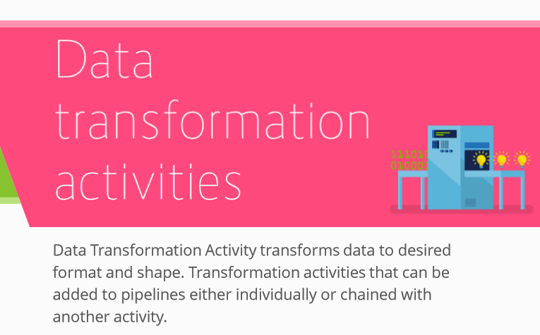
Activity Types

Slide 10
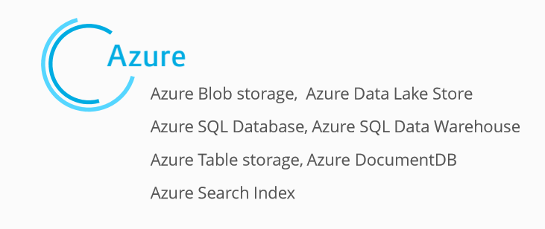
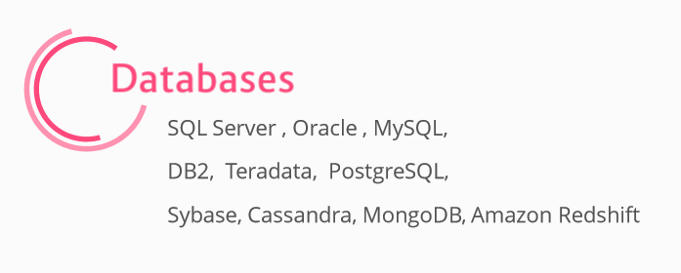
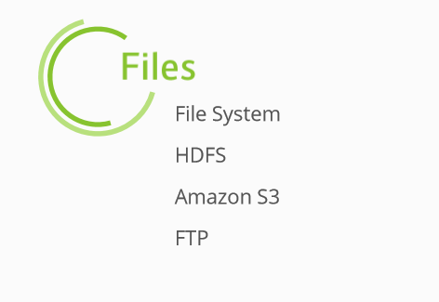
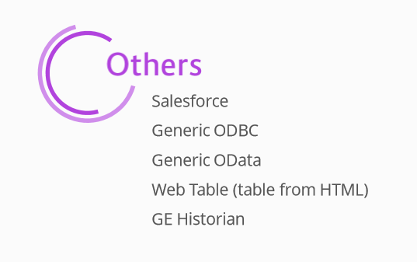
Data Movement Activities

Slide 11
Data Transformation Activities
Hadoop Hive, Pig, MapReduce, Streaming
Machine Learning
Batch Execution
Update Resource
U-SQL
Stored Procedure
.Net

Slide 12
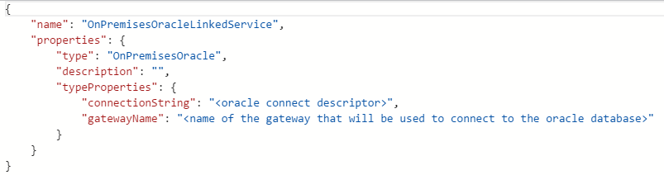
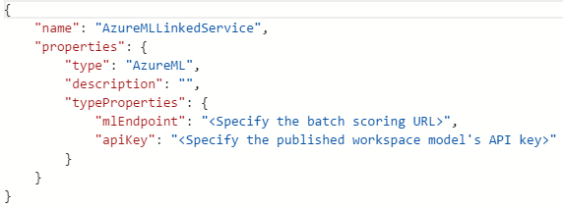
Linked Services
Linked services define the information needed for Data Factory to connect to external resources (Examples: Azure Storage, on-premises SQL Server, Azure HDInsight).

Slide 13
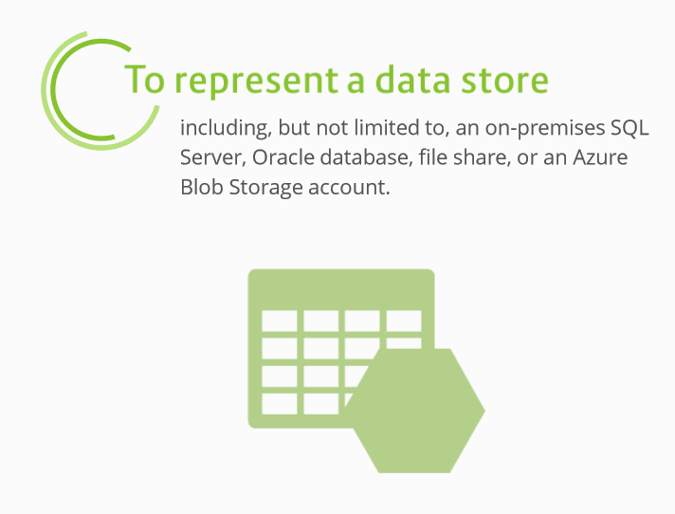
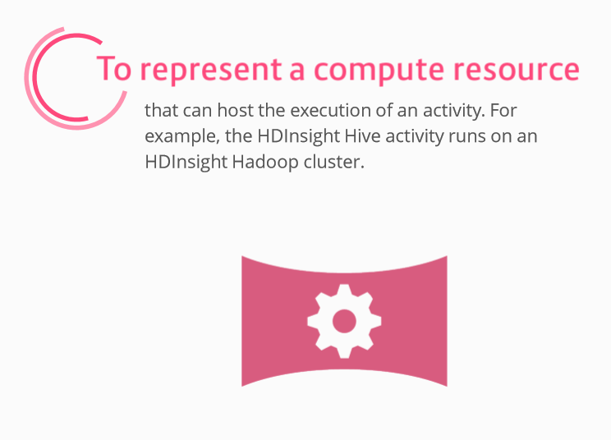
Linked Services

Slide 14
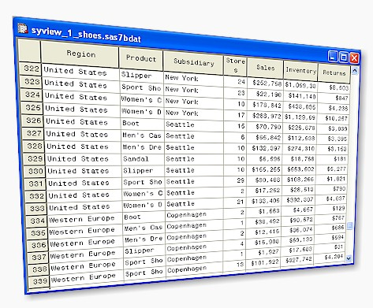
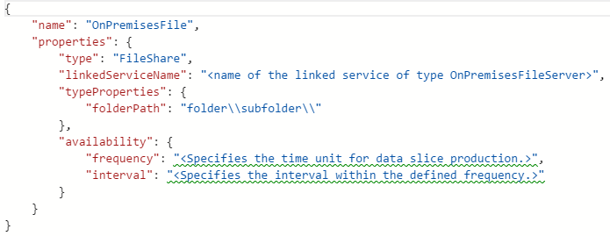
Datasets
Datasets represent data structures within the data stores.
For example, an Azure Storage linked service provides connection information for Data Factory to connect to an Azure Storage account.
An Azure Blob dataset specifies the blob container and folder in the Azure Blob Storage from which the pipeline should read the data.
Similarly, an Azure SQL linked service provides connection information for an Azure SQL database and an Azure SQL dataset specifies the table that contains the data.

Slide 15
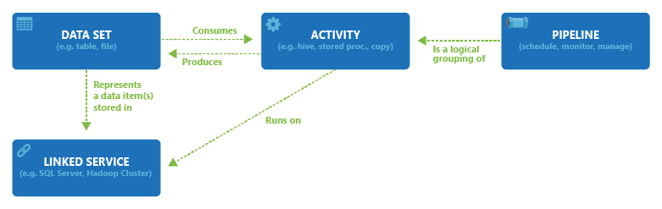
Summarized

Slide 16
Development
JSON for all artefacts
Ease of management by source control
Can be developed using:
Data Factory Editor
In Azure Portal
Create and deploy artefacts
PowerShell
Cmdlets for each main function in PS ARM
Visual Studio
Azure Data Factory Templates
.NET SDK

Slide 17
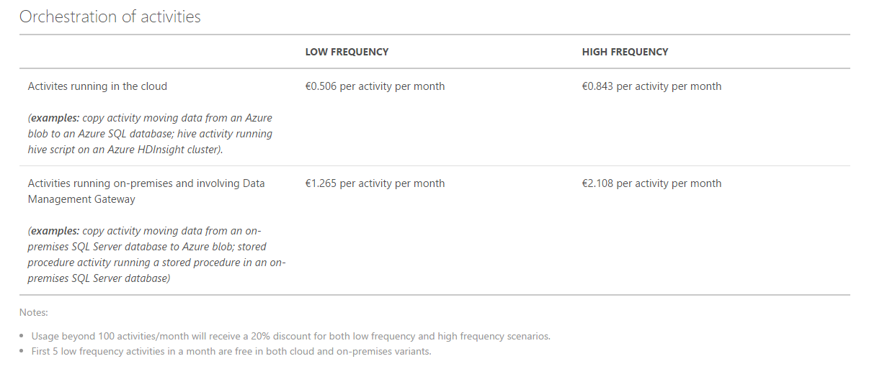
Pricing

Slide 18
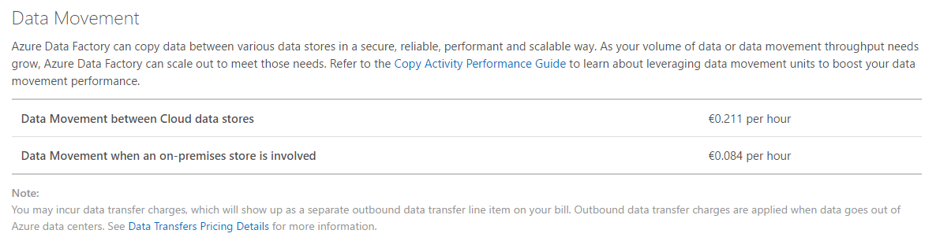
Pricing

Slide 19
Hands-on

Slide 20

http://xpir.it/dambd1

Slide 21
Sources
Thanks to Slava Kokaev and Martin Abbott for their inspiring slides:
http://www.slideshare.net/vkokaev/introduction-to-azure-data-factory
https://www.slideshare.net/biztalk360/a-lap-around-azure-data-factory

